Slide 1

Binary Classification
Date: 20/5/2023

Slide 2
What will we cover today?
Binary Classification
Logistic Regression
K-Nearest Neighbors Classifier(KNNs)
Performance Measures
Confusion Matrix and Error Types.

Slide 3
What is classification ?
Classification is the task that requires the use of supervised ML algorithms to learn how to assign a class label to examples from the problem domain. (discrete problem)
Famous ML classification problem: Classify whether an e-mail is spam or not spam.
Common types of classification problems:
Binary Classification
Multi-Class Classification
And today we will be focusing on Binary Classification.

Slide 4
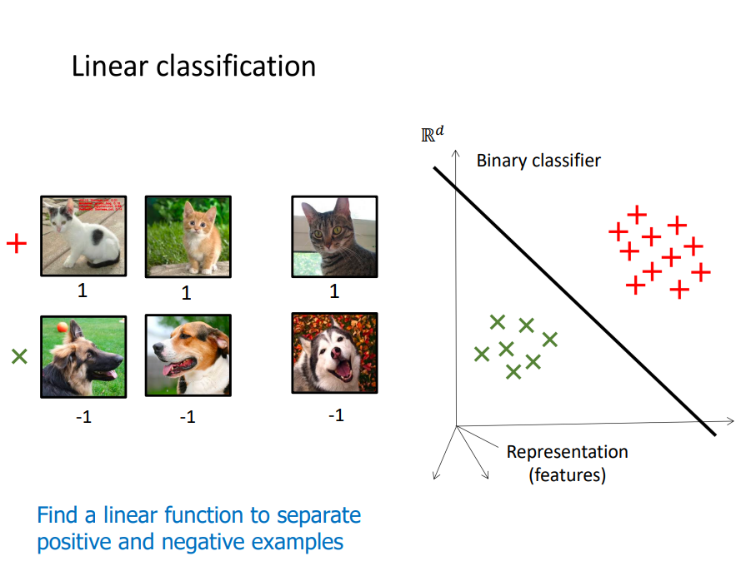
Binary Classification
Binary or Linear Classification is a classification problem where we are trying to separate two classes (0,1) given a set of input features X

Slide 5
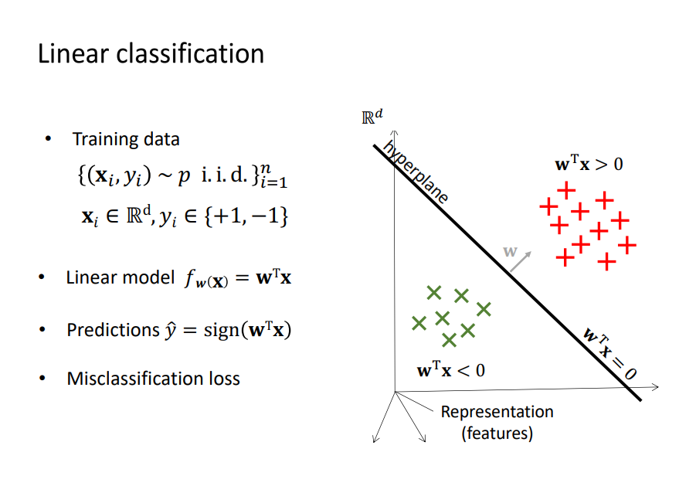
Logistic Regression, How does it work?
LR tries to find the optimal line by which separates the data into two classes (0,1).

Slide 6
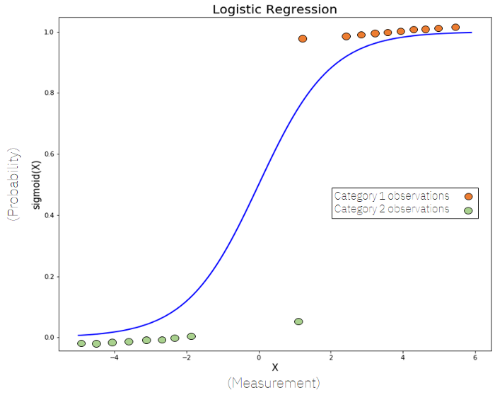
Logistic Regression
logistic regression models are models that have a certain fixed number of parameters that depend on the number of input features, and they output categorical predictions, like for example if a picture is for a dog or a cat. In fact, Logistic regression is very similar to linear regression. But, In Logistic Regression, we don’t directly fit a straight line to our data like in linear regression. Instead, we fit an S-shaped curve, called Sigmoid, into our observations.

Slide 7
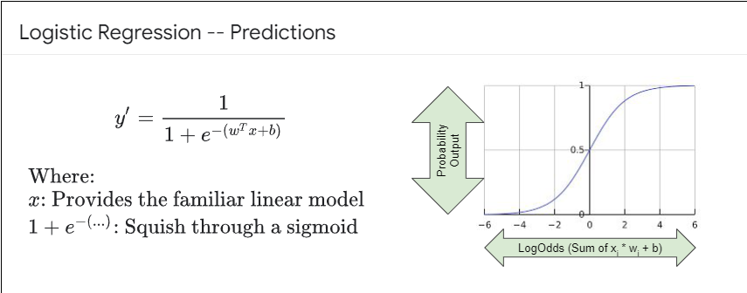
The Sigmoid Function
As we said before Logistic regression is used for binary classification, meaning it can classify things into two classes only, given a set of features. We can see that the y-axis goes from 0 to 1, this is because the sigmoid function outputs the values as maximum and minimum, and it fits well because our goal is to carry out binary classification (0 or 1). By computing the sigmoid function of X (that is a weighted sum of the input features, just like in Linear Regression), we get a probability (between 0 and 1 obviously) of an observation belonging to one of the two categories.

Slide 8
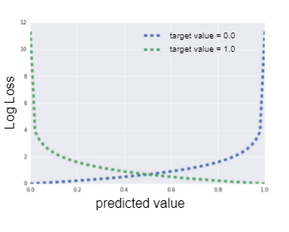

How to calculate the loss and optimize the LR model ?
Since the sigmoid function outputs probabilities between 0 and 1, the loss for the logistic regression is in the form of a log loss. To find the best parameters of the line SGD is also used. L2 regularization is also used to optimize the log loss of logistic regression. The goal is to minimize the log loss.

Slide 9
KNN Classifier
K-nearest neighbours (KNN) is a type of supervised learning algorithm used for both regression and classification. KNN tries to predict the correct class for the test data by calculating the distance between the test data and all the training points. Then select the K number of points which is closest to the test data.
The KNN algorithm calculates the probability of the test data belonging to the classes of ‘K’ training data and the class that holds the highest probability will be selected.
KNN is simple, robust to noise
KNN is not suitable for big data because computation is costly

Slide 10
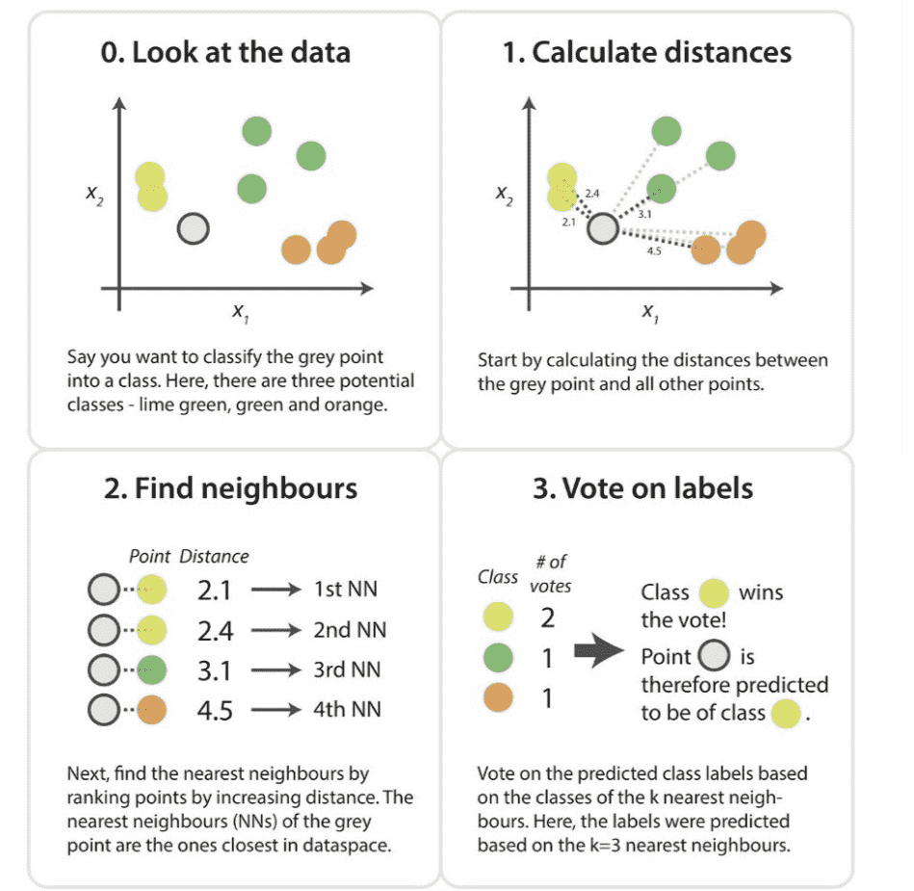
How Does KNN Work?

Slide 11
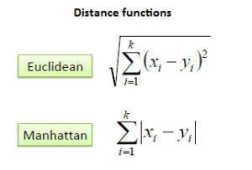
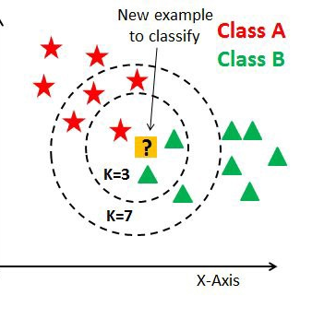
How does KNN Work?
The K-NN working can be explained as follows:
Step-1: Select the number K of the neighbors
Step-2: Calculate the Euclidean distance of K number of neighbors
Step-3: Take the K nearest neighbors as per the calculated Euclidean distance.
Step-4: Among these K neighbors, count the number of the data points in each category.
Step-5: Assign the new data points to that category for which the number of the neighbor is maximum.

Slide 12
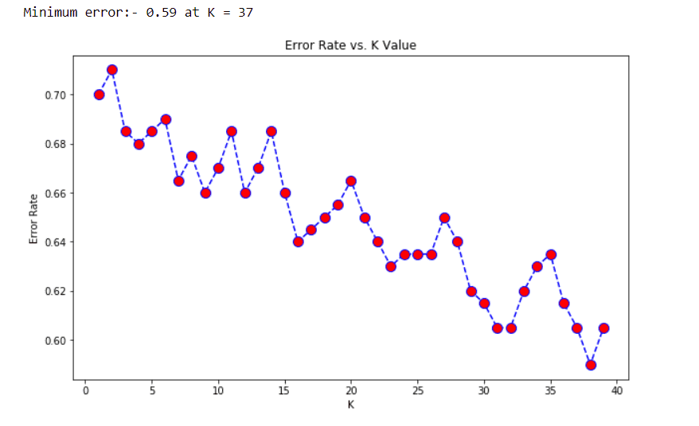
How to choose the optimal K-Value?
There are no pre-defined statistical methods to find the most favorable value of K.
Initialize a random K value and start computing.
Choosing a small value of K leads to unstable decision boundaries.
The substantial K value is better for classification as it leads to smoothening the decision boundaries.
Finding the optimal K value can be done with trial and error, grid-search and a randomized search could be used to find the optimal hyperparameters including the K value.

Slide 13
Performance metrics
To Evaluate the performance of our classifier, we can use the following metrics:
Accuracy
Confusion Matrix
Precision, Recall, F1 Score
We will discuss when is it suitable to use each metric

Slide 14
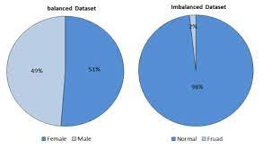
Accuracy
Using Accuracy with classification, unlike regression problems, is usually not a good idea.
It is preferred not to use accuracy in classification problems and especially with imbalanced datasets.
What is an imbalanced dataset?
Data imbalance usually reflects an unequal distribution of classes within a dataset. For example, in a credit card fraud detection dataset, most of the credit card transactions are not fraud and a very few classes are fraud transactions.

Slide 15
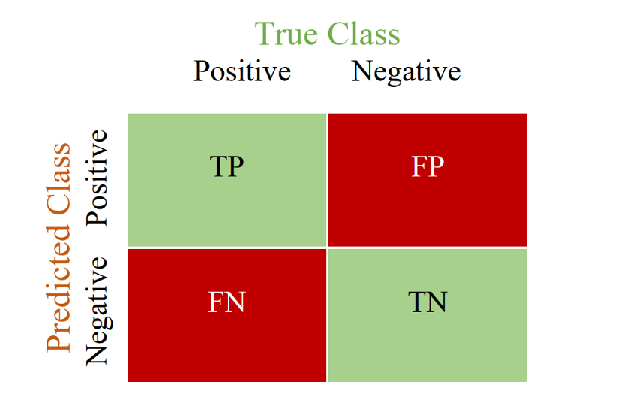

Confusion matrix, Recall, Precision, and F1-Score
Precision= TP/(TP+FP)
Recall= TP/ (TP+FN)
F1-Score= 2* $\frac{Precision∗Recall}{Precision+Recall}$
Where the F1-Score is the harmonic mean of Precision and Recall.

Slide 16
Precision/Recall Tradeoff with examples
Higher Precision Scenarios:
Predicting a good day based on weather conditions to launch satellite:
Missing out to predict a good weather day is okay (low recall) but predicting the wrong weather day (false positive) to launch the satellite can be disastrous.
Email spam detection:
Missing out to detect/classify a spam email is okay (low recall), but no legit or important email must go into the spam folder (false positive).
Higher Recall Scenarios:
Cancer detection:
It is okay to classify a healthy person as having cancer (false positive), but it is not okay to miss identifying a cancer patient as healthy (false negative).
Flagging fraudulent transactions:
It is okay to classify a legit transaction as fraudulent (false positive). But it is not okay to classify a fraudulent transaction as legit (false negative).

Slide 17
References:
https://towardsdatascience.com/understanding-auc-roc-curve-68b2303cc9c5
https://learn.microsoft.com/en-us/previous-versions/azure/machine-learning/classic/evaluate-model-performance
https://towardsdatascience.com/machine-learning-an-error-by-any-other-name-a7760a702c4d
https://medium.com/analytics-vidhya/precision-recall-tradeoff-for-real-world-use-cases-c6de4fabbcd0
https://towardsdatascience.com/the-f1-score-bec2bbc38aa6
https://medium.com/analytics-vidhya/accuracy-on-imbalanced-datasets-and-why-you-need-confusion-matrix-937613bf89bf
https://medium.com/swlh/k-nearest-neighbor-ca2593d7a3c4
https://towardsdatascience.com/logistic-regression-explained-9ee73cede081
https://www.youtube.com/watch?v=yIYKR4sgzI8
https://www.youtube.com/watch?v=Kdsp6soqA7o

